Slide 1

NAWIPS Migration to AWIPS II
Status Updates
2015 Unidata Users Committee
NCEP Central Operations
March, 2015

Slide 2


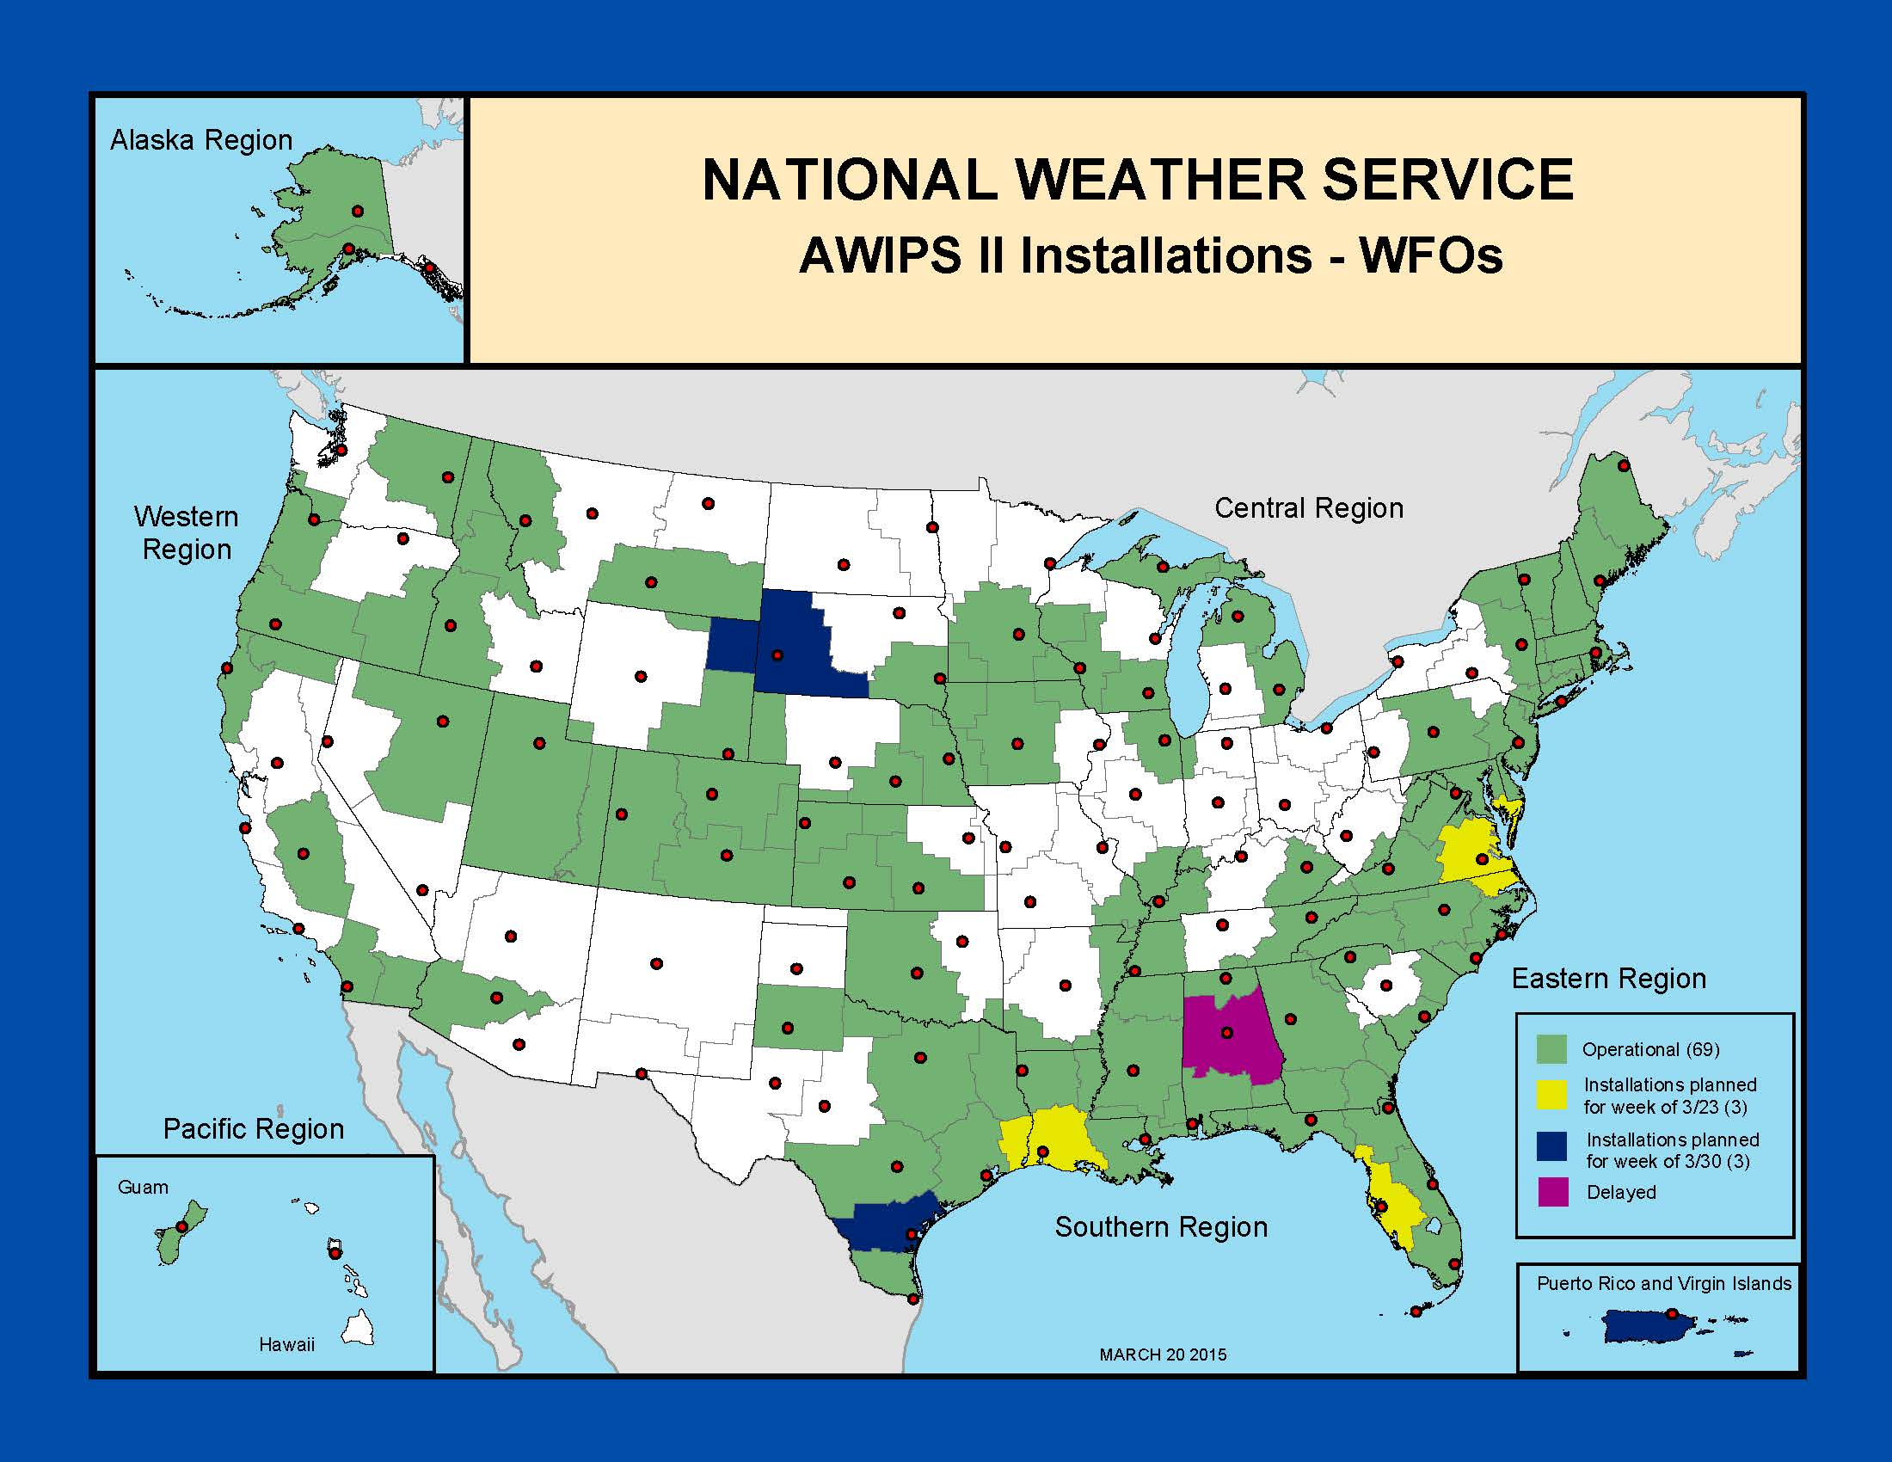
AWIPS Status
Group 1-6 sites (60) completed. Sites installed with OB14.2.4
Remaining sites
with OB14.3.1:
Group 7 sites (17) by 3/31
Group 8 sites (13) by 4/29
Group 9 sites (11) by 5/27
Group 10 sites (13) by 6/30
with OB14.4.1:
Group 11 sites (5) by 7/29
Group 12 sites (4) by 8/28
Last site (HFO) by 9/30
2

Slide 3
AWIPS Release Schedule
OB14.2.4 – November 10, 2014
OB14.3.1 – February 23, 2015
OB14.3.2 – March 30, 2015
OB14.4.1 – June 1, 2015
OB15.1.1 – September 8, 2015
OB16.1.1 – December 14, 2015
OB16.2.1 – mid March, 2015 (estimated date not yet negotiated)
Note: Content of each release is available at the Vlab AWIPS Community, SREC area
  https://vlab.ncep.noaa.gov/group/awips-community/srec
3

Slide 4
NAWIPS Migration Plan
Primary focus on going live with Ocean Prediction Center(OPC) and removing their NAWIPS systems by March 2016
Other centers will proceed in accordance with their plan
4

Slide 5
NAWIPS Migration Plan
The Build deployment process will be redesigned to ensure NCP updates are implemented as fast as possible after the National Build.
Improved Communication: Monthly meetings on project(s) status will include NWS management, NCEP OD and APO
Launch and complete the projects that resulted from the AWIPS Summit meeting in September 2014. (FY15 start – FY16 finish)
  Wind/Wave Project (OPC)
  Non-SBN Satellite Data Project (NHC)
  Non-SBN Gridded Data Project (AWC)
  High-Resolution Model Display Performance Project (SPC)
5

Slide 6
Latest Developments
National Center Perspective
PGEN is now available in D2D
Working on displaying oceanographic model data, as well
as the results of the NOS GNOME (transport) model
Also:
Representatives from NCO are involved in the AWIPS contract recompete.
6

Slide 7
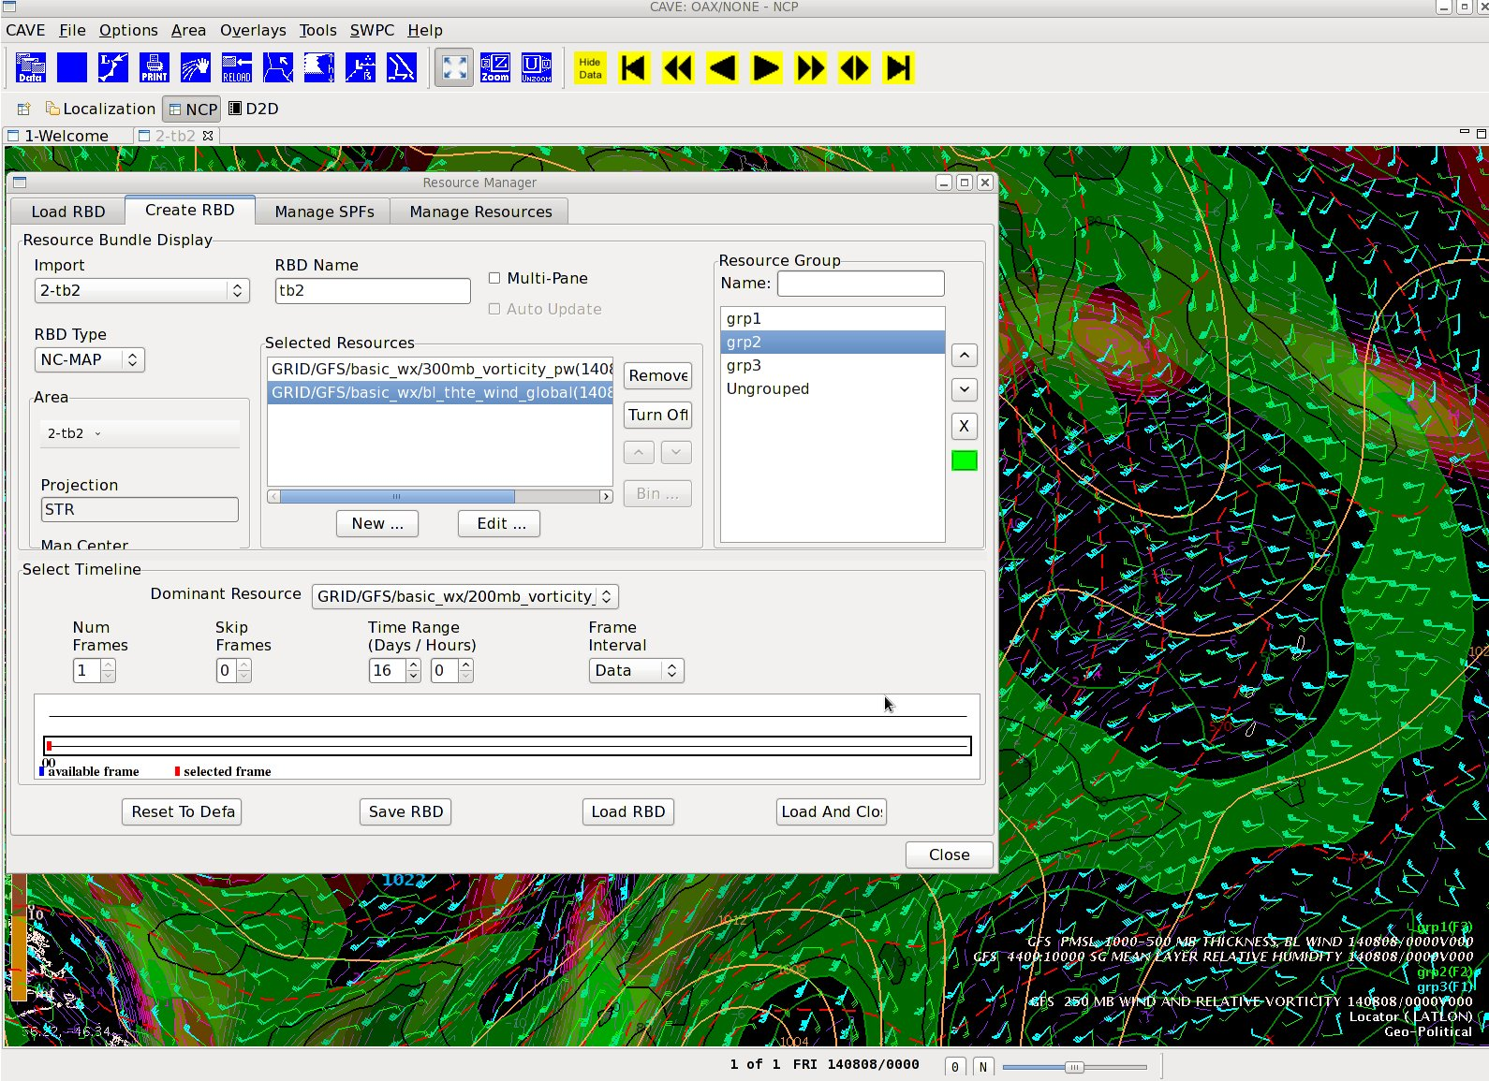
Latest Developments:
Power Legend
Power Legend
  Allows for maximum data loading within a single CAVE footprint
  Users can group Resources within a single Display
  Groups considered equivalent of NMAP “loops”
    Tied to hotkeys
7

Slide 8
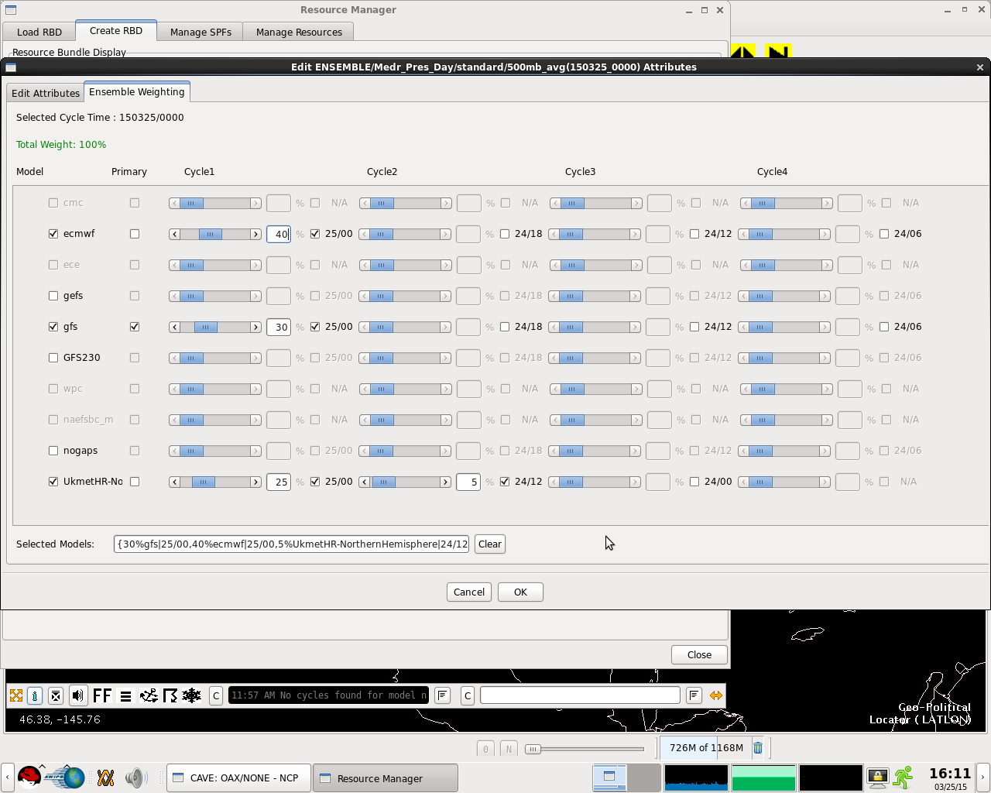
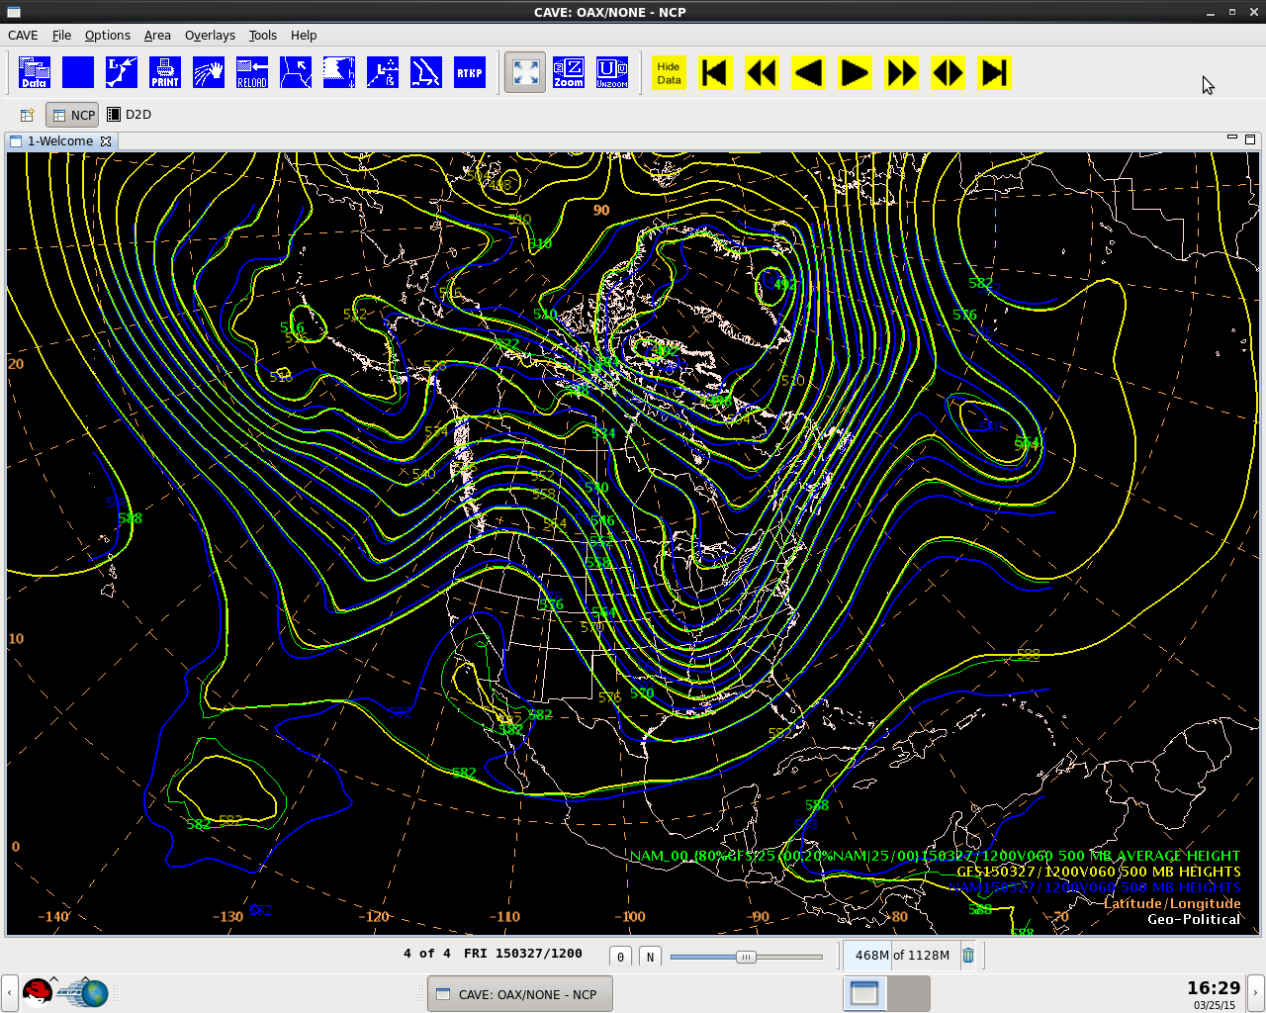
Latest Developments:
WPC Blender
Enhancements allow freedom to
choose and weight multiple models
with full power of the GEMPAK
grid diagnostics and NCP
rendering capabilities
8

Slide 9
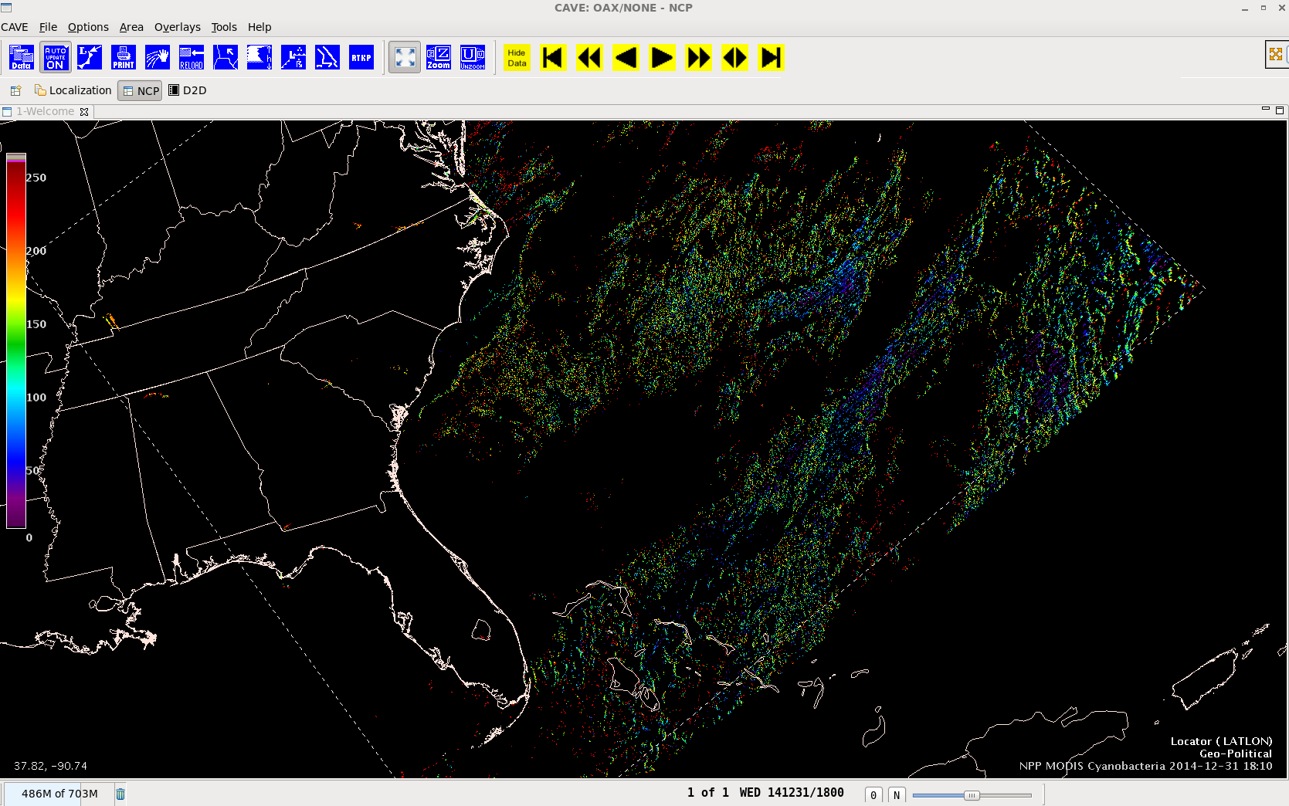
Latest Developments
NCP – Imagery Display
MODIS CoastWatch MODIS imagery (Cyanobacterial Index - CI )
National Ocean Service imagery is used in the Harmful Algae Bloom (HAB) product creation
9

