Slide 1

Where is My Tie?
Or, My Personal Journey with Unidata
Tim Spangler
16 October 2009

Slide 2
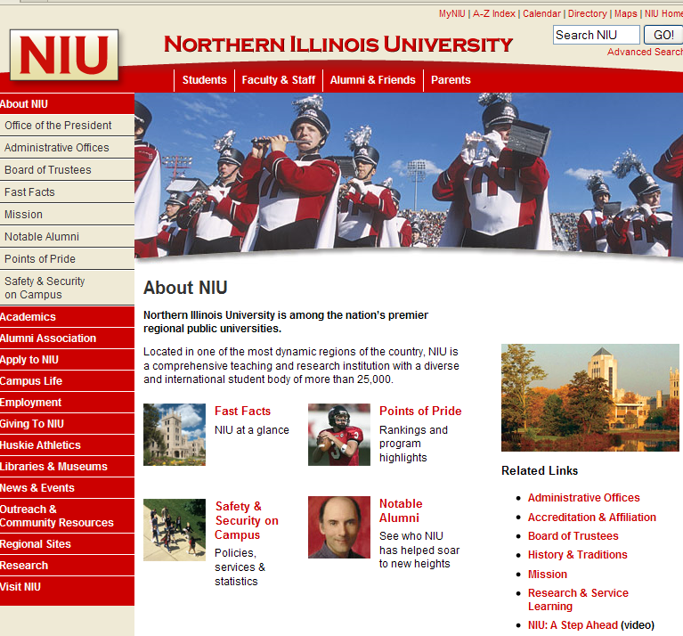
September 1985

Slide 3
The Early Years
September 1985
Chair hands new Assistant Professor Spangler article on Unidata
Spring 1986
May 1986
Spangler submits proposal to NSF
Convinces Dean to offer $30,000 matching funds
First meeting with Dave Fulker in Boulder (Marine Street)
Discover paper route connection

Slide 4
The NSF Award
August 1986
NIU awarded only Unidata equipment grant in country
September 1986
Valerie Lee (NSF) does NIU site visit

Slide 5
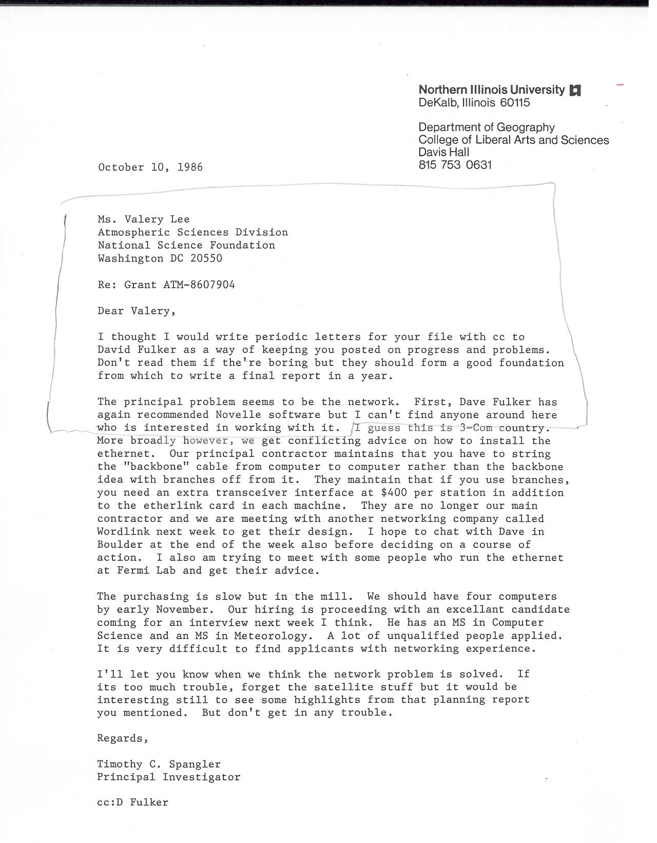
Letter to Valery Lee, 10 October 1986

Slide 6
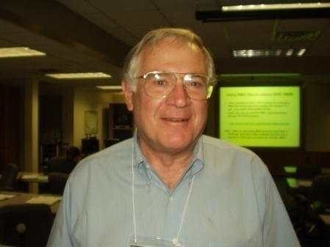
The Project Starts
Winter 1987
Computers installed
Spring 1987
McBe committee
Students told “no word processing”
REU Grant
Summer 1987
Dean Forgets to recover Zephr monthly costs ($1,500/mo)
Fall 1987
NIU asked to start “Floater Image”
Junior Assistant Professor Spangler becomes network administrator
Discovers how to command a simulated cold boot to change operating system
[DOS to OS/2]
Bob Gall

Slide 7
Questions in 1987
NSF and UCAR need support for Unidata
Fulker borrows tie
Spangler writes letters in support of small schools and Unidata
Fulker invites Spangler to Washington to meet with NSF

Slide 8
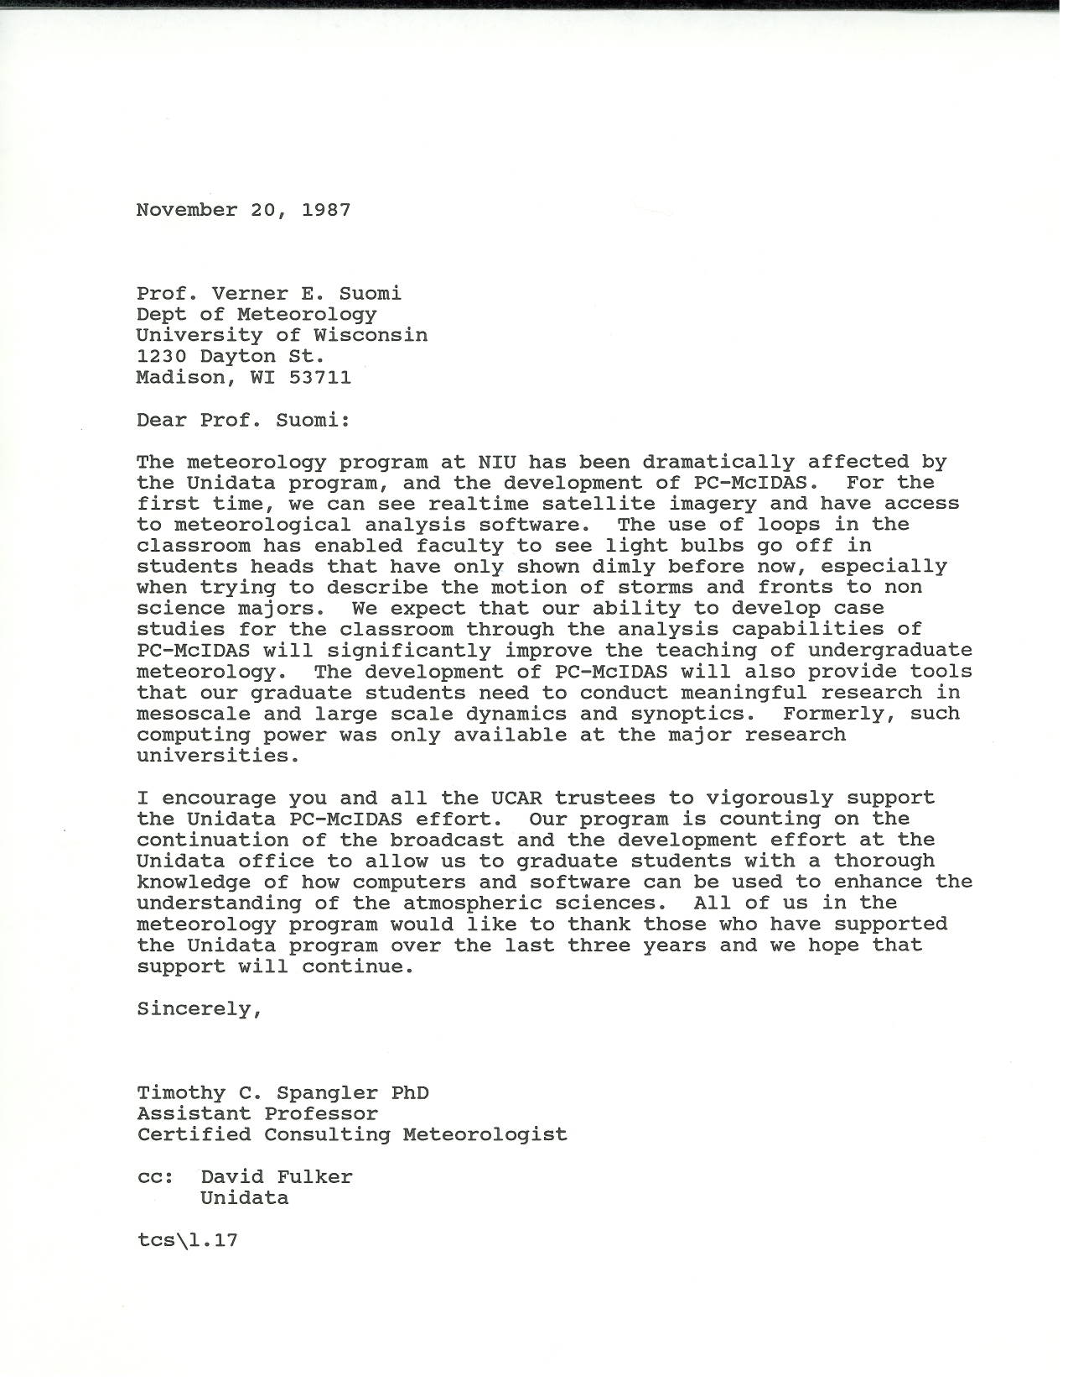

Slide 11
Post McBe Era
Spring 1988
Spangler and Gall on Policy Committee
Spangler and Gall annoy Dutton with emphasis on small schools

Slide 12
The next slide summarizes the highlights of the 65 policy committee meetings I attended

Slide 14
Two Programs:
Unidata & COMET
Unidata/COMET Faculty workshop
Progressive dinners
Friendly competition for universities [COMET clearly the Winner]
Unfriendly competition at softball

Slide 15
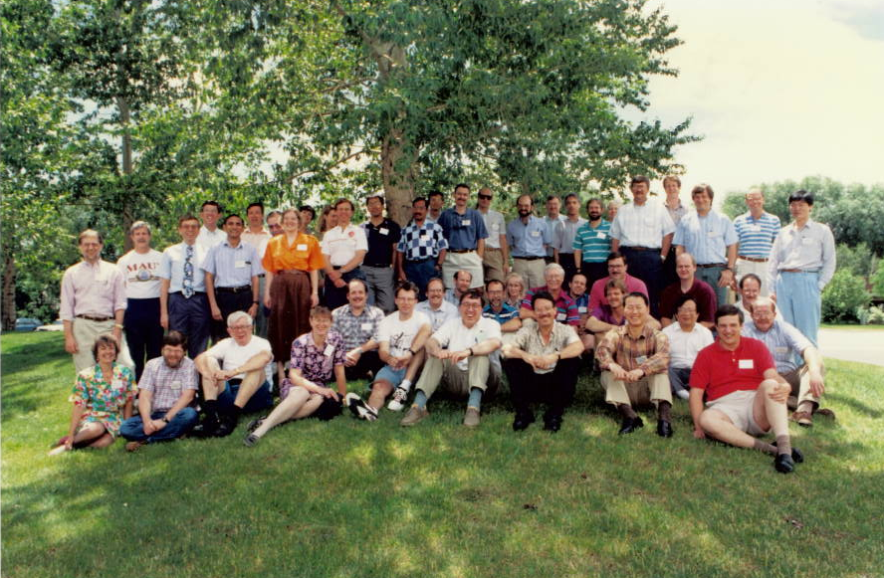
1994 - Mesoscale Meteorological Instruction Workshop

Slide 16
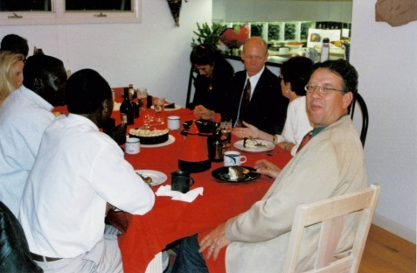
1 of 2

Slide 17
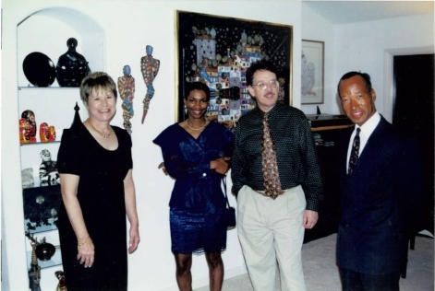
2 of 2

Slide 18
Circa 1998
2000
2001
Fulker and Spangler go to WMO in Geneva
Fulker and Spangler go to Venezuela
Unidata and COMET from MeteoForum project to support training centers in Barbados, Costa Rica, Venezuela, Brazil, Argentina
And Go International Together

Slide 19
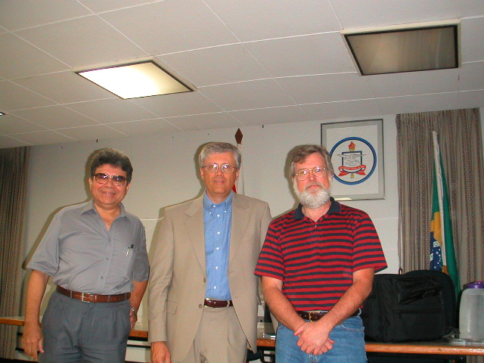
Universidade Federal do Para, Brazil

Slide 20
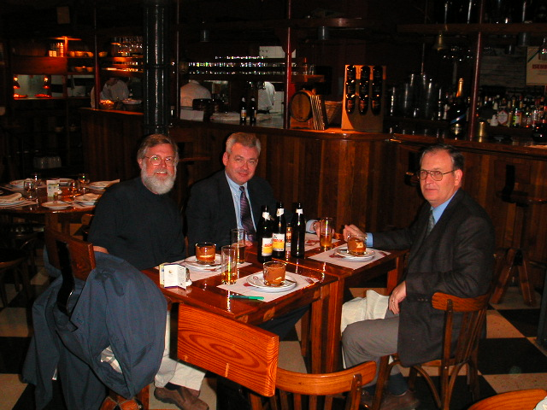
Argentina Meteorological Service Training Center, Buenos Aires

Slide 21
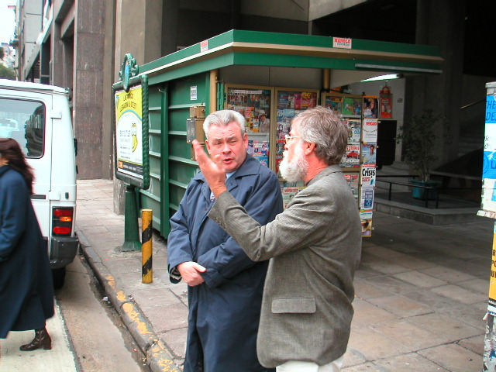
Argentina Meteorological Service Training Center, Buenos Aires

Slide 22
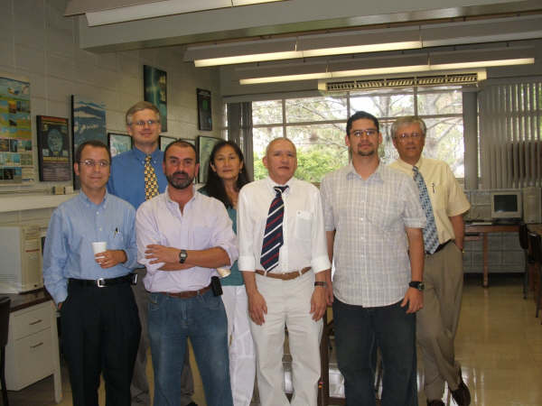
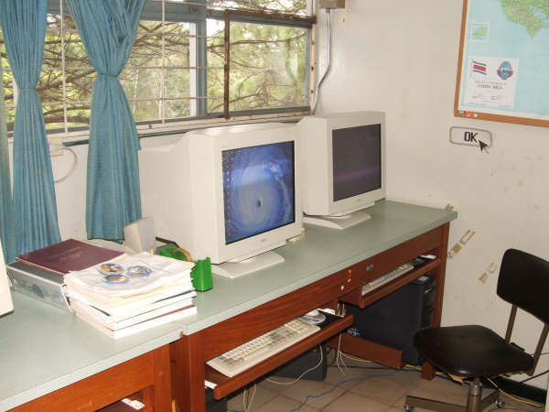
University of Costa Rica

Slide 23
1985 - 2009
With the support of the National Science Foundation Unidata:
Supports
Sustains
Stimulates
Serves
Small university programs across the nation that contribute to a scientifically and environmental literate nation.

Slide 24
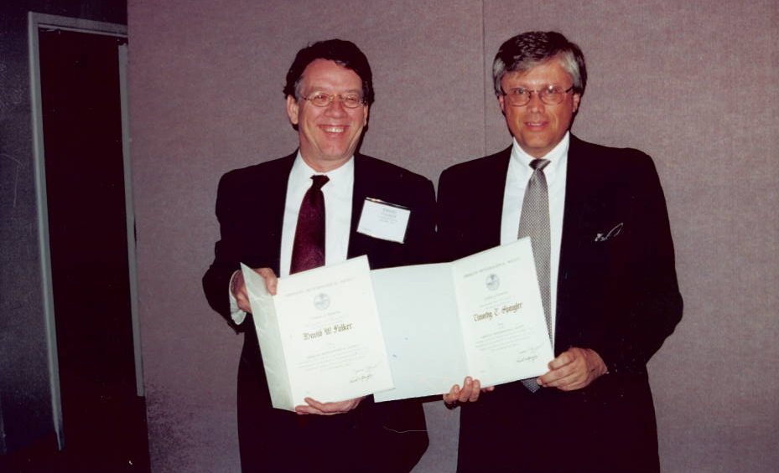
Is that my tie?

Slide 25
The End

Slide 26
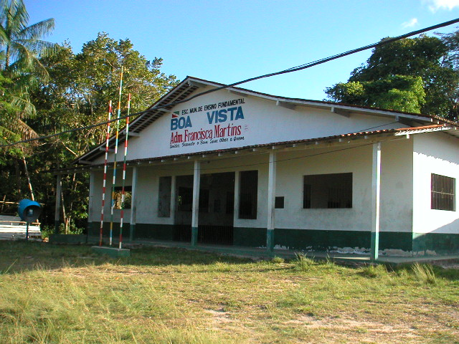
Rural Brazilian Primary School

Slide 27
COMET, 36
Unidata, 112

