Slide 1
Non-standard ASCII to netCDF

Slide 2
CF Conventions REQUIRE Latitude Longitude Date/Time …for EVERY observation

Slide 3
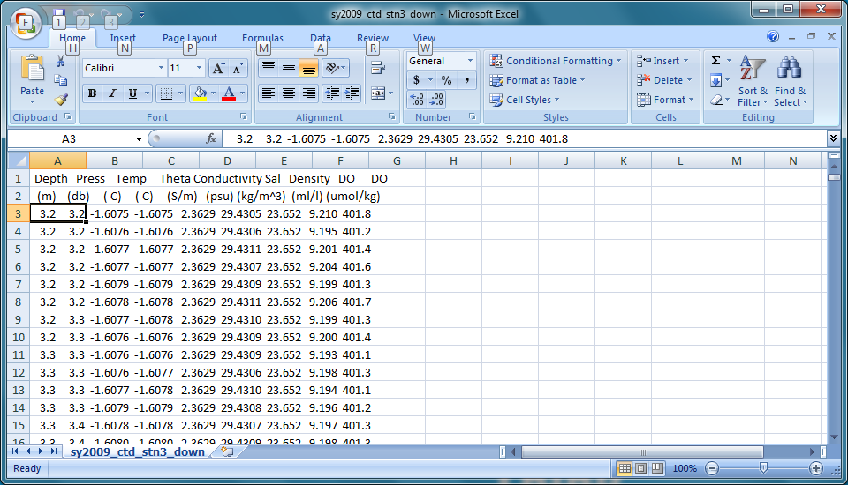
Bad ASCII

Slide 4
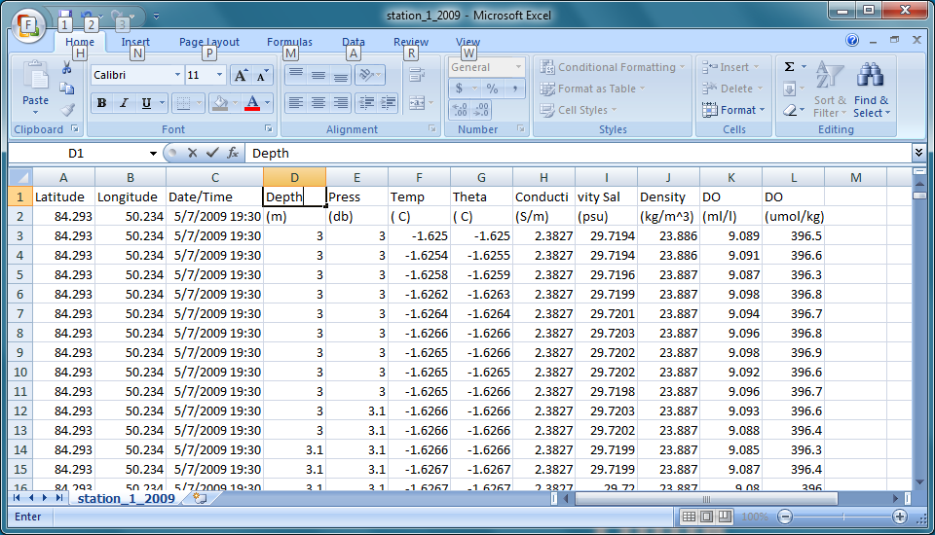
Better ASCII

Slide 5
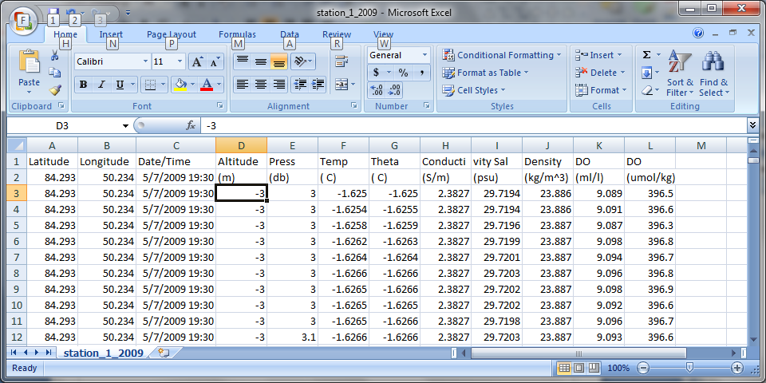
Best (conforming) ASCII

Slide 6
Options
Have PI’s submit data in netCDF
Have PI’s submit data in CF -> netCDF compliant ASCII
Accept any data in any form

Slide 7
.xls is the most used data format
Complete (conforming) ASCII can readily be transformed to netCDF.
Non-standard data formats will likely not be supported by funding agencies in the future.

Slide 8
How to ingest non-standard ASCII data into the IDV for display and export to netCDF
Step one – Add missing fields to file to become CF netCDF compliant: via Excel or editor of choice and save as a .txt file (Tab, space, or comma separated)
Latitude
Longitude
Date/Time

Slide 9
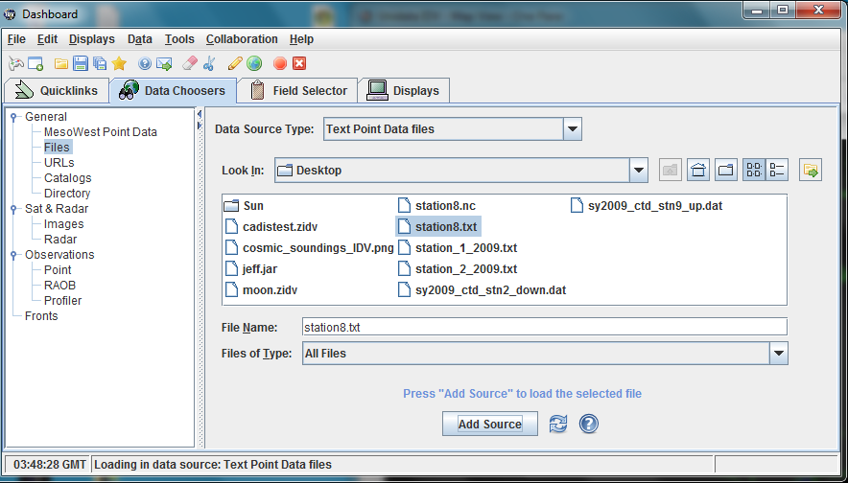
Step Two: Import file to IDV from Dashboard “File” -> “Open” ..as “Text Point Data files”, then “Add Source”

Slide 10
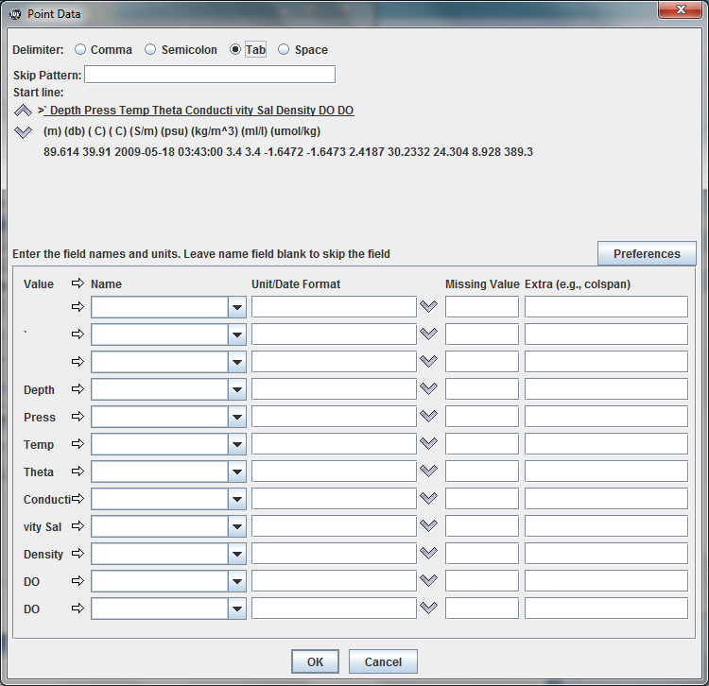
A “Point Data” GUI will pop-up. -Select appropriate “Delimiter”

Slide 11
Use the up and down arrow keys to scroll down to where the data begins then enter the variable names and units of the data set as needed. You can use the “pull down” menus for some pre-populated fields.
Once entered save off via “Preferences” and name as desired, then this process will not need to be repeated for like datasets.

Slide 12
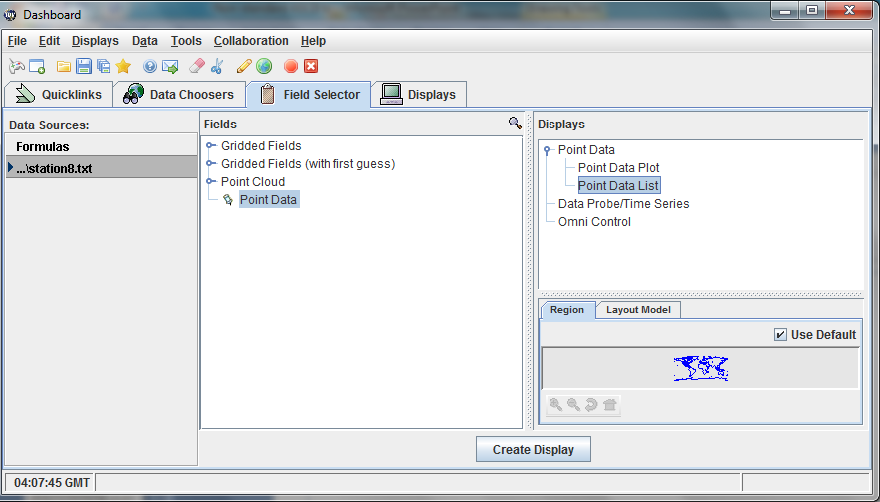
The “Dashboard” will display and under “Fields”, select “Point Data” and under “Displays” select “Point Data List”, then “Create Display”

Slide 13
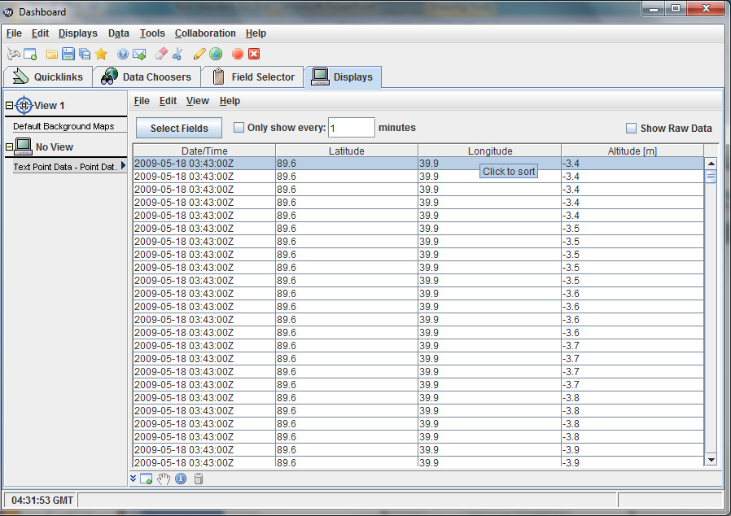
The “Dashboard” will display and you must now enter your desired variables via “Select Fields”. Generally, one will add all.

Slide 14
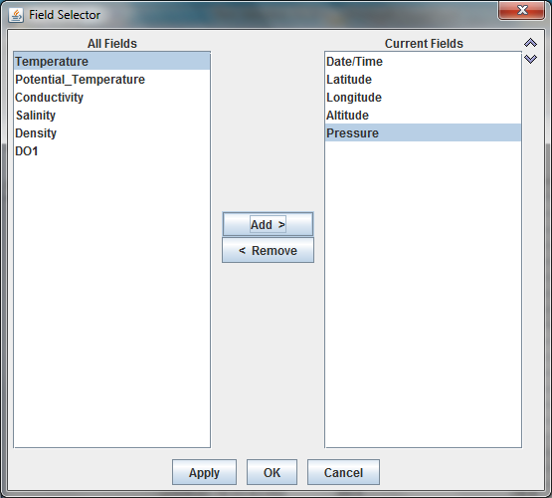

Slide 15
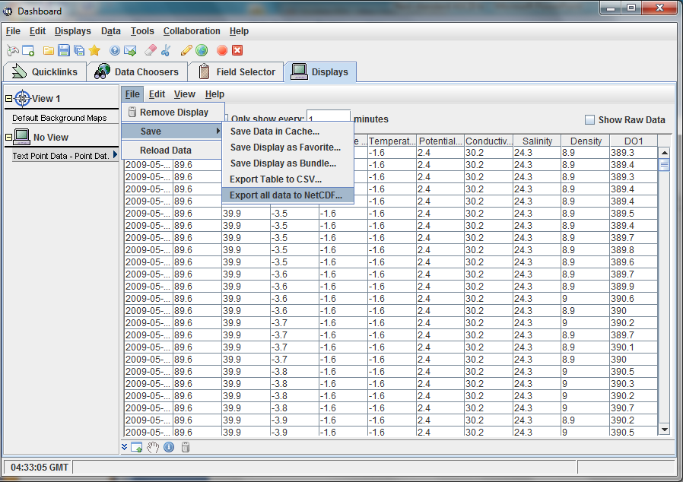
Then, “File” -> “Save” -> Export all data to NetCDF

Slide 16
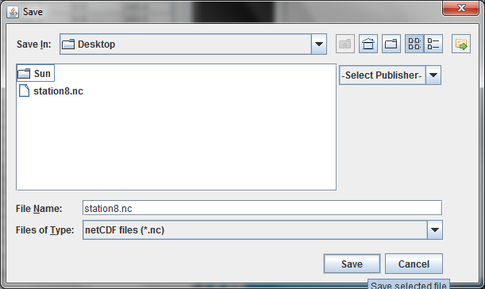
Name *.nc and “Save” as desired

Slide 17
Resources
IDV Users Guide
7.5.1 and others
NetCDF Users Guide

